Slide 1
Expert Lecture on DevOps Engineering (Concept and Methodology)
By,
Mr. Kapil Sawankar (FIS Solutions India Private Limited, Pune)

Slide 2
Contents :
Why DevOps ?
What is DevOps ?
DevOps History
DevOps Architecture
DevOps Components
DevOps Lifecycle
Workflow
DevOps Tools
DevOps Automation
DevOps Pipeline and Methodology
Roles and Responsibility
Azure DevOps
AWS DevOps
Interview Questions

Slide 3
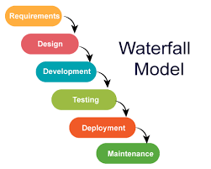
Why DevOps ?
Waterfall Model:
Waterfall Model methodology which is also known as Linear Sequential Life Cycle Model.
Waterfall Model followed in the sequential order, and so project development team only moves to next phase of development or testing if the previous step completed successfully.

Slide 4
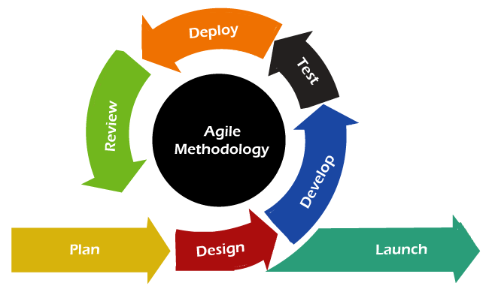
Why DevOps ?
Agile Model :
Agile methodology is a practice that helps continuous iteration of development and testing in the software development process. In this model, development and testing activities are concurrent, unlike the Waterfall model. This process allows more communication between customers, developers, managers, and testers.

Slide 5
Why DevOps ?
Waterfall Model | Agile Model
Waterfall is a linear sequential software development life cycle model. | Agile is a continuous iteration of development and testing in the software development process.
Waterfall is a structured software development methodology | The Agile methodology is known for its flexibility
Agile performs testing concurrently with software development | Waterfall methodology, testing comes after the “Build” phase.
Waterfall has no scope of changing the requirements once the project development starts | Agile allows changes in project development requirements

Slide 6
What is DevOps ?
DevOps is Methodology in Agile Software Development Model which includes the Continuous Integration and Continuous Delivery or Deployment strategy. (CI/CD)
DevOps is act is a governor between Developer and Operations
It is the Combination of two words i.e. Development and Operations.
It is help to reduce the disconnection between, Developer, Quality Analyst and administrator.

Slide 7
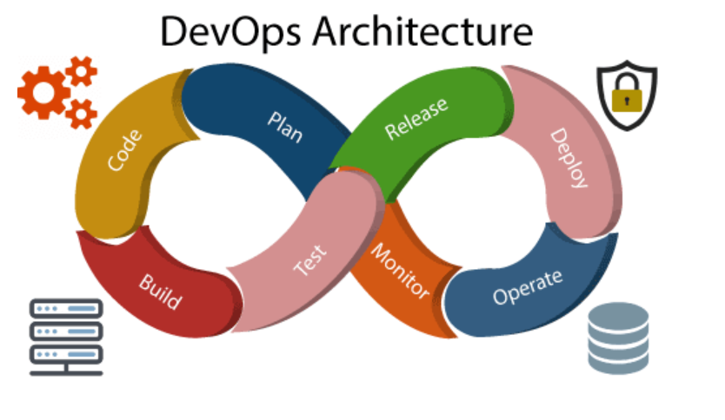
DevOps Architecture

Slide 8
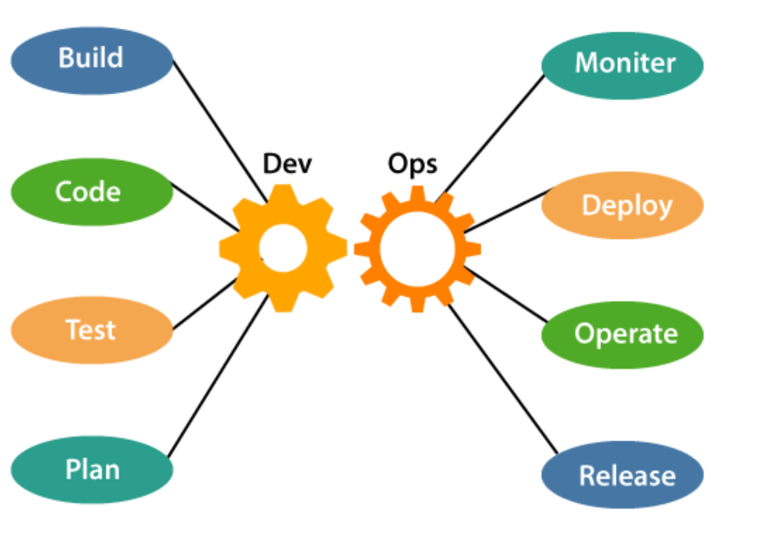
DevOps Components

Slide 9
DevOps Components
Build
Without DevOps, the cost of the consumption of the resources was evaluated based on the pre-defined individual usage with fixed hardware allocation. After DevOps the usage of cloud, sharing of resources comes into the picture, and the build is dependent upon the user's need, which is a mechanism to control the usage of resources or capacity.
Code
Git enables the code to be used, which ensures writing the code for business, helps to track changes, getting notified about the reason behind the difference in the actual and the expected output, and if necessary, reverting to the original code developed. The code can be appropriately arranged in files, folders, etc. and they can be reused.
Test
The testing can be automated, which decreases the time for testing so that the time to deploy the code to production can be reduced as automating the running of the scripts will remove many manual steps.

Slide 10
DevOps Components
Plan
DevOps use Agile methodology to plan the development. With the operations and development team in sync, it helps in organizing the work to plan accordingly to increase productivity.
Monitor
Continuous monitoring is used to identify any risk of failure. Also, it helps in tracking the system accurately so that the health of the application can be checked.
The monitoring becomes more comfortable with services where the log data may get monitored through many third-party tools such as Splunk.
Deploy
Deployment of the application is required for application to be highly available within or out-side the network.

Slide 11
DevOps Components
Operate or Support
DevOps use Agile methodology to plan the development. With the operations and development team in sync, it helps in organizing the work to plan accordingly to increase productivity.
Release
Deployment to an environment can be done by automation. But when the deployment is made to the production environment, it is done by manual triggering. Many processes involved in release management commonly used to do the deployment in the production environment manually to lessen the impact on the customers.

Slide 12
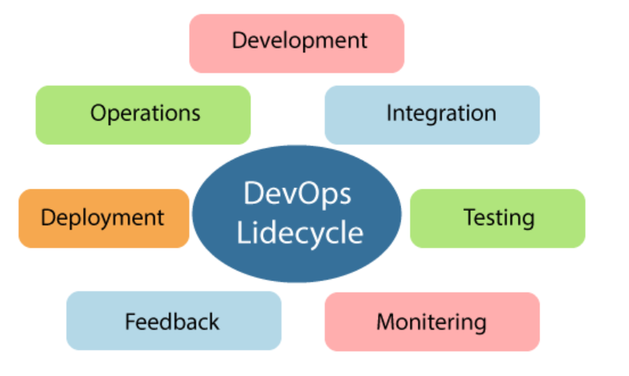
DevOps Lifecycle
DevOps defines an agile relationship between operations and Development. It is a process that is practiced by the development team and operational engineers together from beginning to the final stage of the product.

Slide 13
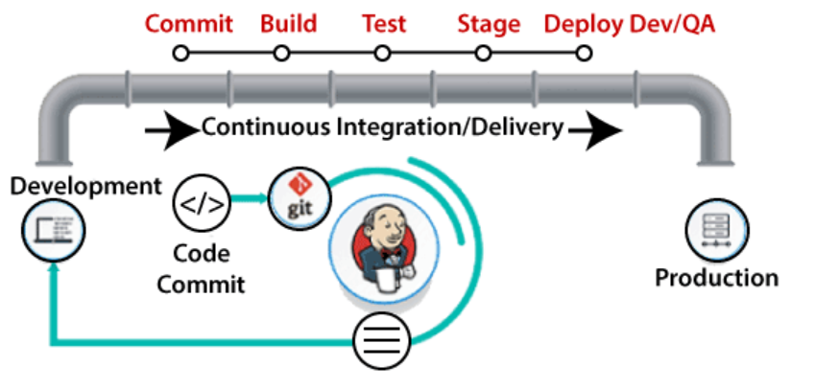
DevOps Tools
GIT
Bitbucket
Maven
Nexus
Jenkins
Terraform
Docker
Kubernetes
Ansible
Grafana

Slide 14
GIT
Git is known for source code Management Tools or distributed version control tool.
It is used to make changes in code in local repository and used to push them in remote or central repository.
Every Developer has their own local GIT account.
Basic Commands:
git init ---------------→ to initialize the new repository
git –version ------→ to check the version of git
git clone <repository path> --------- to get copy of remote repository in local system (local repository)
git branch -------- to make new feature branch
git checkout ------- to switch from one branch to another branch
Git add –all
Git commit –m “commit message”
git push

Slide 15
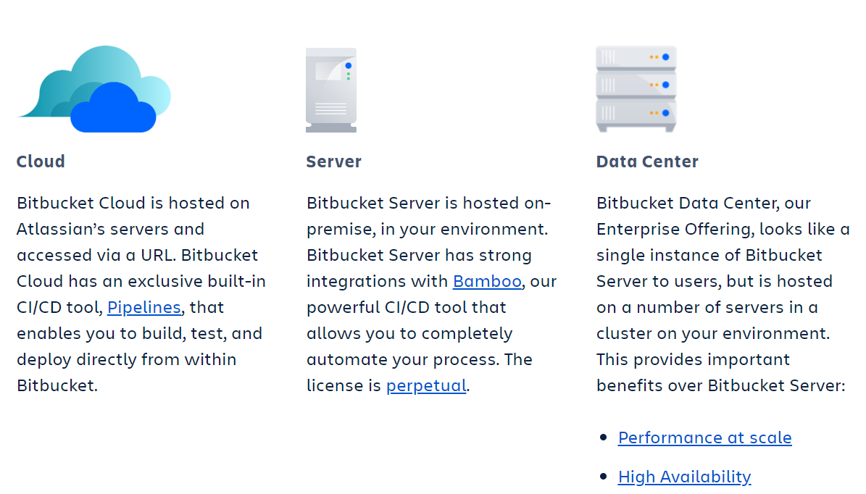
Bitbucket
Bitbucket Cloud is a Git based code hosting and collaboration tool, built for teams. Bitbucket's best-in-class Jira and Trello integrations are designed to bring the entire software team together to execute on a project.
https://bitbucket.org/

Slide 16
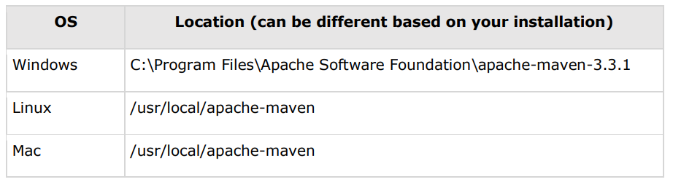
Maven
Apache Maven is software project management and comprehension tool.
It works on concept of Project Object Model (POM), Maven Manages the project builds.
Maven is a Java based tool, so the very first requirement is to have JDK installed on your machine.
Install the JDK File. (Java Downloads | Oracle)
Set the Java environment by exporting the variable as per the Windows, Linux and MAC configuration.
Download Maven Archive from http://maven.apache.org/download.html.
Down the file apache-maven-3.3.1-bin.tar.gz
Untar the file untar -xvzf apache-maven-3.3.1-bin.tar.gz
Set the Maven Environment Variable
Version check using command mvn --version

Slide 17
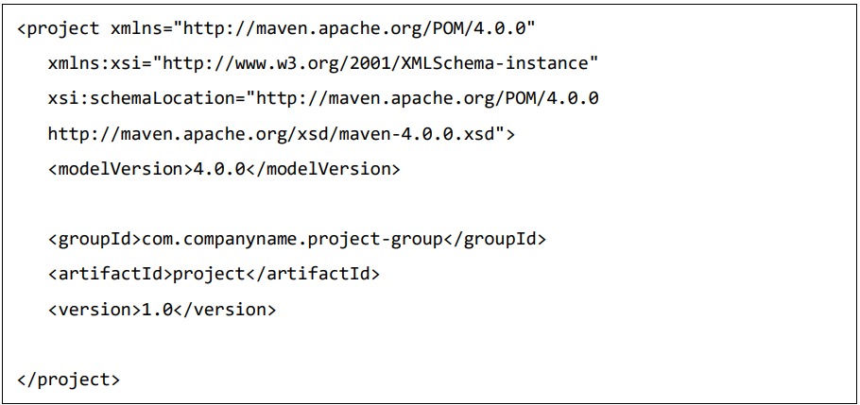
Maven – POM
POM stands for Project Object Model.
It is an XML File which resides in base directory of project as POM.XML
POM contains dependencies and the information which requires for builds of project with all configuration details of project.
configuration that can be specified in the POM are following:
Project Dependencies
Plugins
Goals
Build Profiles
Project Version
Developers
Mailing list

Slide 18
Maven – POM
POM stands for Project Object Model.
It is an XML File which resides in base directory of project as POM.XML
POM contains dependencies and the information which requires for builds of project with all configuration details of project.
configuration that can be specified in the POM are following:
Project Dependencies
Plugins
Goals
Build Profiles
Project Version
Developers
Mailing list

Slide 19
Maven – POM
There should be single POM file for each project.
All POM files require the project element and three mandatory fields: groupId, artifactId, version.
Node | Description
Project Root | This is project root tag. You need to specify the basic schema settings such as apache schema and w3.org specification.
Model Version | Model version should be 4.0.0.
groupId | This is an Id of project's group. This is generally unique amongst an organization or a project. For example, a banking group com.company.bank has all bank related projects.
artifactId | This is an Id of the project. This is generally name of the project. For example, consumer-banking. Along with the groupId, the artifactId defines the artifact's location within the repository.
version | Project Release Version

Slide 20
Maven – Build Life Cycle
A build life cycle is well defined sequence of phases, which defines the order in which the goals are to be executed. Here phase represents a stage in life cycle.
Phases | Description
Validate | Validates if the project is correct and if all necessary information is available
Compile | Source code compilation is done in this phase.
Test | Tests the compiled source code suitable for testing framework.
Package | This phase creates the JAR/WAR package as mentioned in the packaging in POM.xml
Install | This phase installs the package in local/remote maven repository.
Deploy | Copies the final package to the remote repository.

Slide 21
Maven – Commands
Following are the mail commands of Maven.
mvn clean
mvn package
mvn deploy

Slide 22
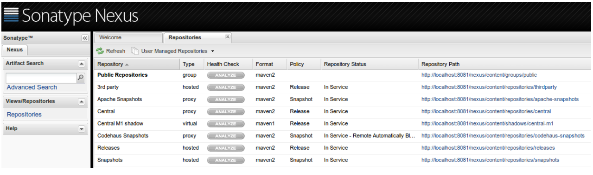
Nexus (Remote Repository Manager)
Nexus is Artifactory Management tool.
It is also known as Maven central repository manager.
Remote Repository Manager (Jfrog/Nexus) to manage project binaries.

Slide 23
Jenkins
Jenkins is powerful application that allows the continuous integrations and continuous delivery of the project.
It is a free source that can handle any kind of build or continuous integration.
You can integrate Jenkins with several testing and deployment technologies.
With the help of Jenkins, organizations can speed up the software development process through automation.
Using Jenkins we can perform free style project, Pipeline project (single branch and multibranch), WebHook trigger, Build Periodically, Project level access management, Jenkins level access management, Plugin Management.

Slide 24
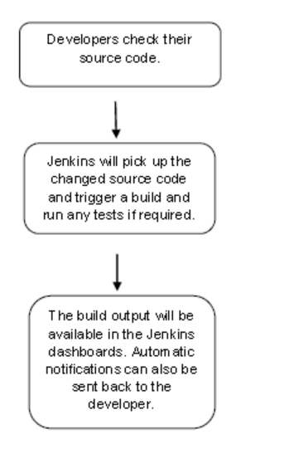
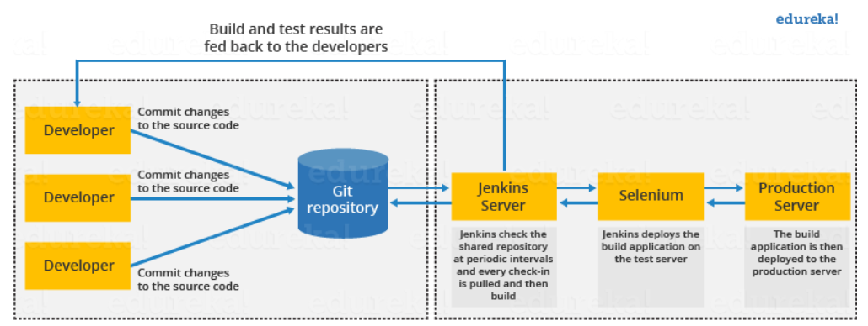
Jenkins
Working flow of Jenkins:

Slide 25
Jenkins
How Jenkins Works:
At First, a developer commits the code to the source code repository. Meanwhile, Jenkins checks the source code commit at regular interval of time.
After commits occurs, the Jenkins server finds the changes that have occurred in the source code repository. Jenkins will draw those changes and will start preparing a new build. (GitHub WebHook Trigger)
If the build fails, then the concerned team will be notified.
If built is successful, then Jenkins server deploys the built in the test server.
After testing, Jenkins server generates a feedback and then notifies the developers about the build and test results.
It will continue to verify the source code repository for changes made in the source code and the whole process keeps on repeating.

Slide 26
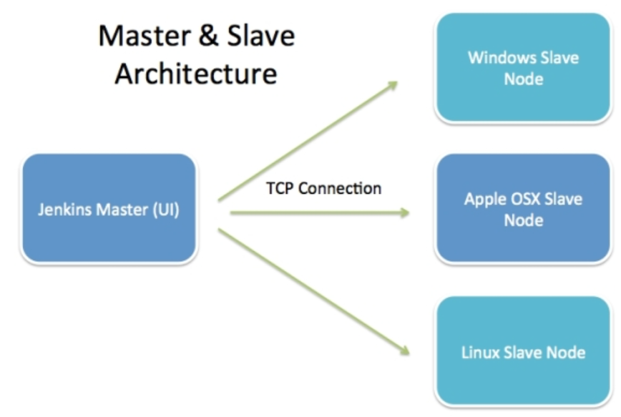
Jenkins Slave Architecture
Jenkins Architecture has two components:
Jenkins Master/Server
Jenkins Slave/Node/Build Server

Slide 27
Jenkins Slave Architecture
Jenkins Master/Server
The main server of Jenkins is the Jenkins Master.
It is a web dashboard which is nothing but powered from a war file. By default, it runs on 8080 port.
With the help of Dashboard, we can configure the jobs/projects, but the build takes place in Nodes/Slave.
By default, one node (slave) is configured and running in Jenkins server.
We can add more nodes using IP address, username and password using the ssh.

Slide 28
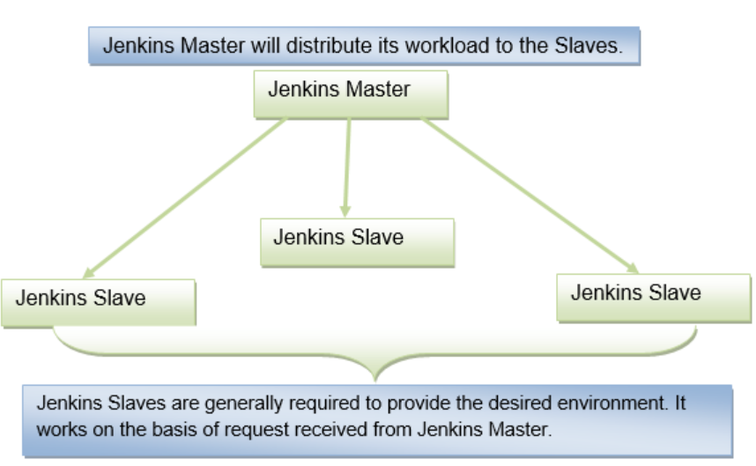
Jenkins Slave Architecture
Jenkins Slave/Node/Build Server
Jenkins slave is used to execute the build jobs dispatched by the master.
We can configure a project to always run on a particular slave machine, or particular type of slave machine, or simply let the Jenkins to pick the next available slave/node.

Slide 29
Terraform
Terraform is infrastructure automation tool wide using to build the infrastructure in very fast way.
It is developed by the company name HashiCorp.
It is also known as Infrastructure as a Code tool
instead of implementing the infrastructure manually, the desired infrastructure is written in codes.
It is works on all cloud infrastructure provider like, AWS, Microsoft Azure, Google Cloud and Vsphere.
Terraform is a plugin-based tool.
Terraform code files have extension with .tf

Slide 30
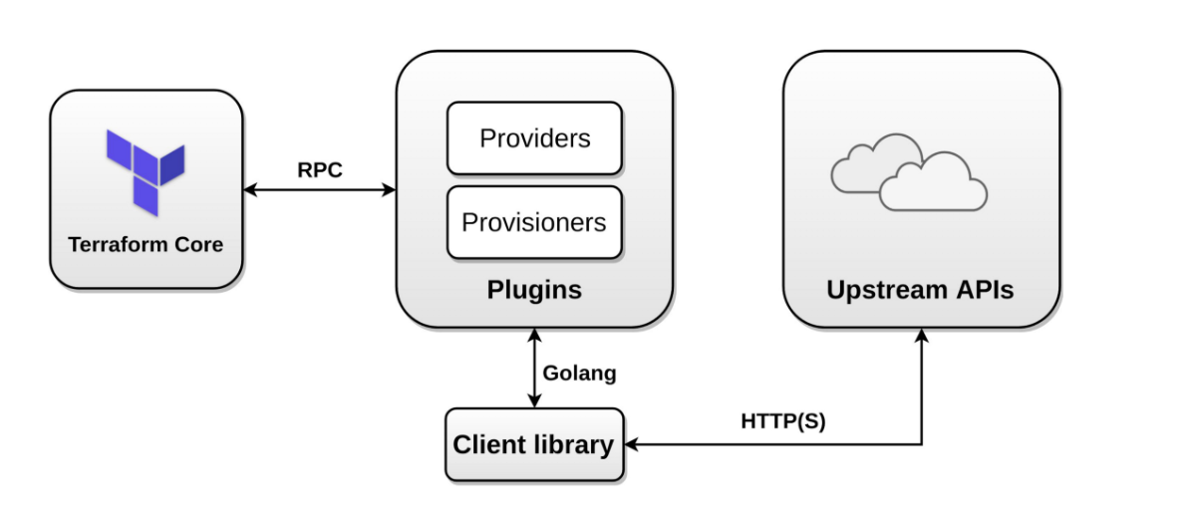
Terraform Architecture

Slide 31
Terraform files :
Important files:
main.tf
provider.tf
varialble.tf
core_slaves.tf

Slide 32
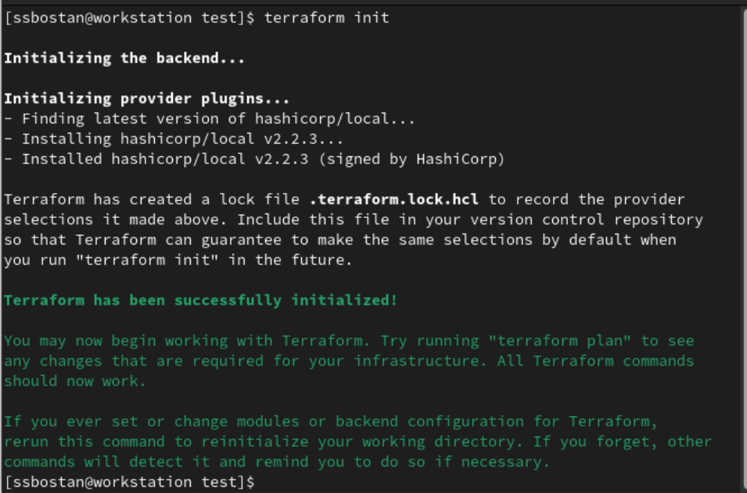
Terraform Commands :
terraform init: initialize the working directory
terraform validate: to check all provisions are correct or not
terraform plan: to execute the plan
terraform apply: to execute the actual changes

Slide 33
Docker
Docker is a platform for running applications in an isolated environment called a "container" (or Docker container).
It maintainer consistent computing power through out the software development life-cycle.
It is known containerization tools.
Keyword for Docker are Develop Ship and Run.
Virtualization | Containerization
One physical machine has multiple OSs residing on it and appears as multiple machines. | The application developed in a host environment with same OS and the same machine executes flawlessly on multiple different environments.
Startup-time is higher that containers | Start-up time is slower that VM.
VM’S are resource-heavy hence slower | Containers are slower
It virtualize the underlying hardware | Container virtualize the operating systems

Slide 34
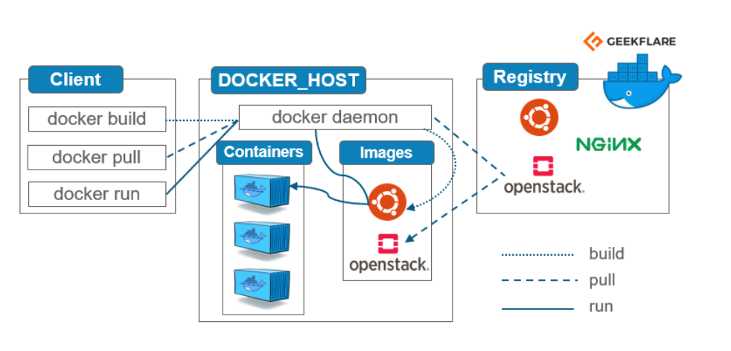
Docker Architecture

Slide 35
Docker Commands
systemctl docker start ------- to start docker daemon
Systemctl docker status -------- to check docker daemon status
systemctl docker stop ---------- to stop the docker daemon
docker pull ----------- to pull the image from registry
docker start ---------- to start stopped container
docker run --------- to create and run the container from docker image
docker ps –a --------- to check the running container
docker stop ------- to stop the running container
docker login <container name or container id>
docker system prune -------- to erase all the container which are stop
Docker rename ------ to rename the container
Docker rm ---------- to remove one or more container

Slide 36
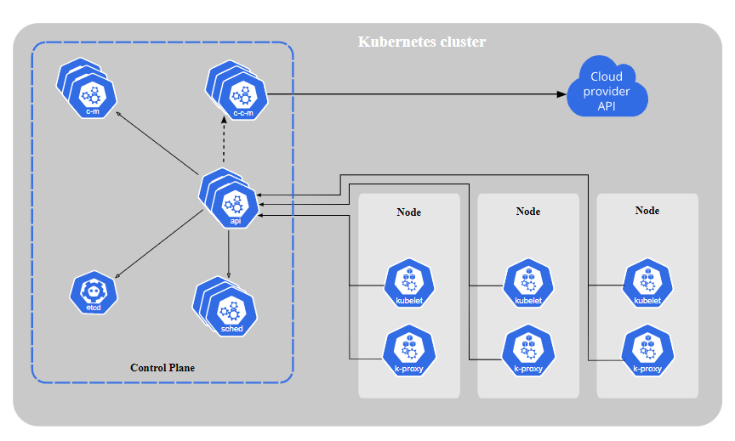
Kubernetes
Kubernetes also known as K8s, is an open-source system for automating deployment, scaling, and management of containerized applications.
Kubernetes is also called container orchestration or container management tool.
It is developed by google and written in golang language.
It groups the containers and keeps in one Kubernetes cluster.

Slide 37
Kubernetes Components:
Control Plane Components:
KubeAPIServer
etcd cluster
kube-scheduler
Kube-controller-manager
Node Component:
Kubelet
Kubeproxy
pod

Slide 38
Ansible and Grafana
Ansible is server configuration management tool
Grafana is Dashboard monitoring tool

Slide 39
Questions……….?

